Slide 1
HCI AND ITS APPLICATION
TO IOT
ZWICKEXPLORER
Presentation By Shubha Mahesh, Ravi Verma and Pavan Karehalli Manjegowda
PTI90050
Tutor: Prof. Dr.-Ing. Rainer Wasinger
Westsächsische Hochschule Zwickau

Slide 2


PROCESS
Research
Brainstorming
Concept Maps
Paper Sketches
Testing
Wireframes

Slide 3

PROJECT DESCRIPTION
The objective of this project was to design an application that educates users about the sights in Zwickau associated with composer Robert Schumann. The app focuses on features such as navigation to the sights, detailed information about each location, and more.
The project was carried out in numerous stages, as mentioned in the methodology. Making paper designs appropriate for testing was a challenging procedure, but it was also a crucial stage that enabled us to make multiple iterative design adaptations.

Slide 4
GOALS
Create a Mobile application that educates users to learn about Zwickau's sights related to Robert Schumann through interactive and engaging content.
Objectives:
Recognize fundamental ideas including accessibility, the design process, and user-centered design.
Determine the essential features that are required.
Develop features that allow users to learn about Robert Schumann-related Zwickau landmarks through captivating and interactive information.
Develop a low-fidelity prototype design by brainstorming.
To test the application, make low-fidelity paper sketches.
To test the low-fidelity sketches, create a series of test activities.
Conduct testing with two to three users.
Create a wireframe in Balsamiq and make adjustments in accordance with the testing that has been finished.

Slide 5

FUNCTIONALITIES
Required Functionalities:
Additional Functionalities:
Intuitive Navigation
Games for active engagement
Language support in English and Detusch
Camera Feature for image recognition
User friendly application to all kind off users
Login and Register options
Important Notifications
Bookmarking Sights
ZwickSights - overall Sights
Sharing Progress on external application.

Slide 6
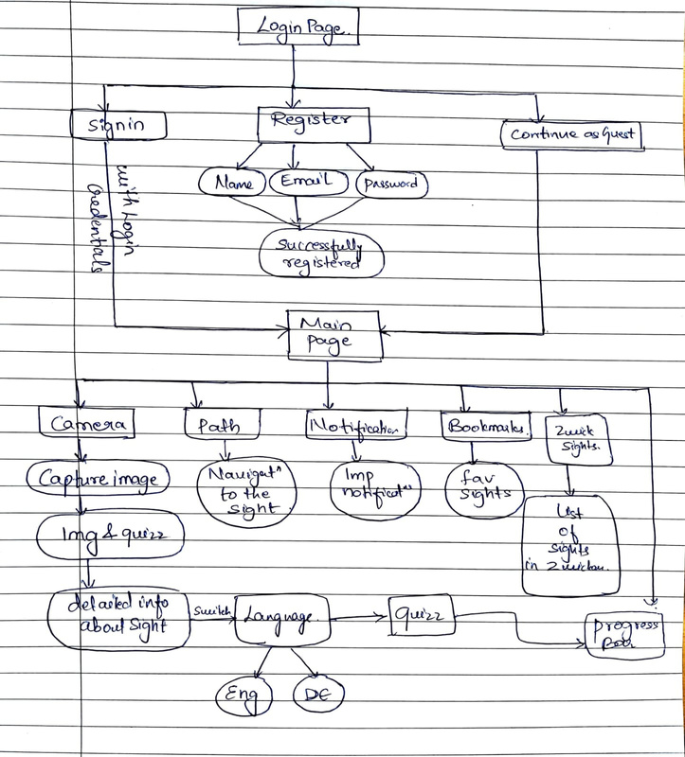
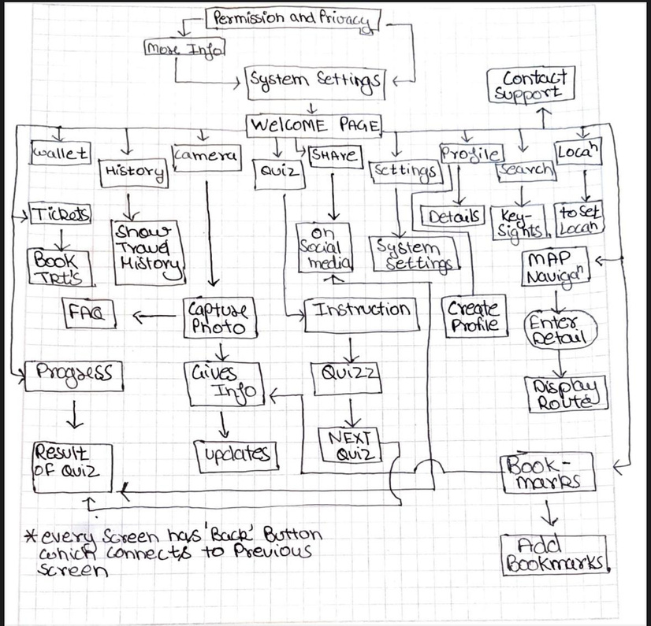
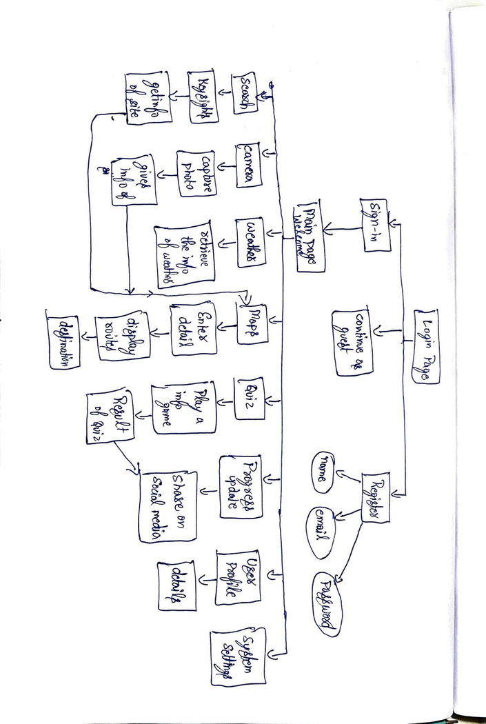
FLOW CHARTS

Slide 7
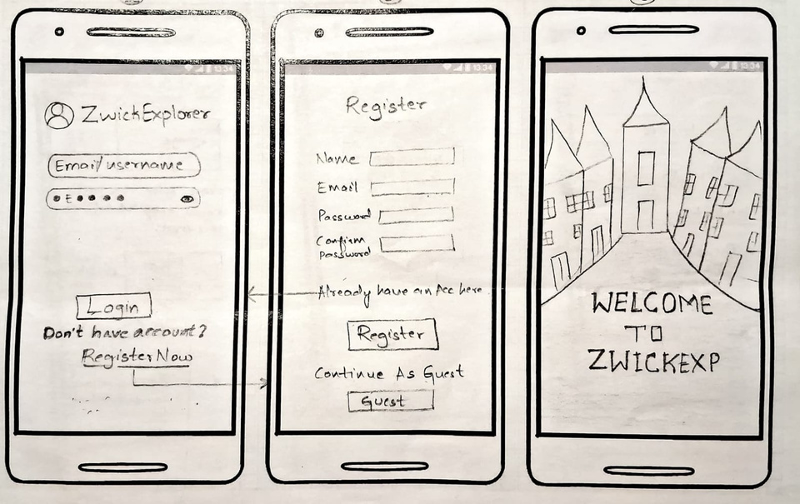
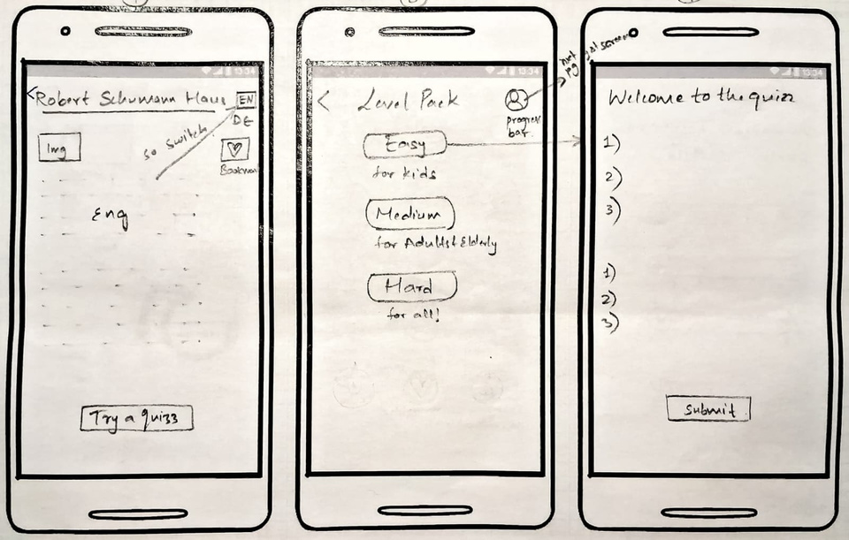
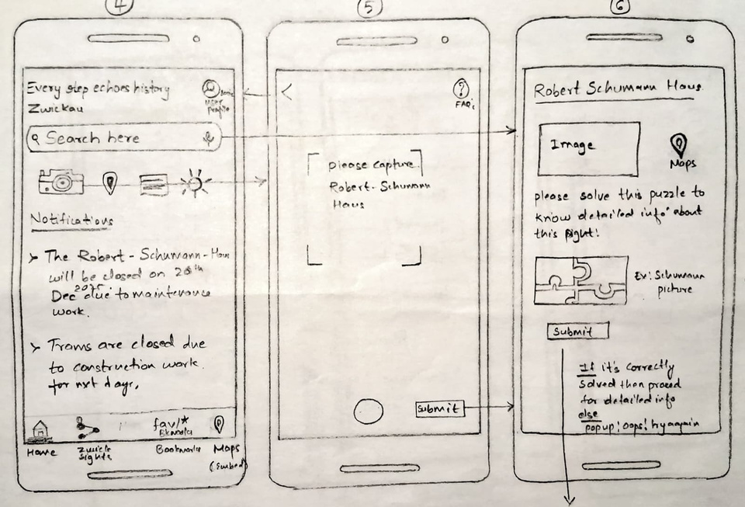
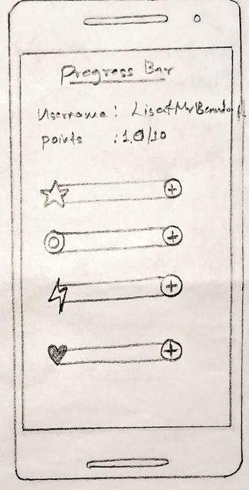
PAPER PROTOTYPES
Shubha Mahesh

Slide 8
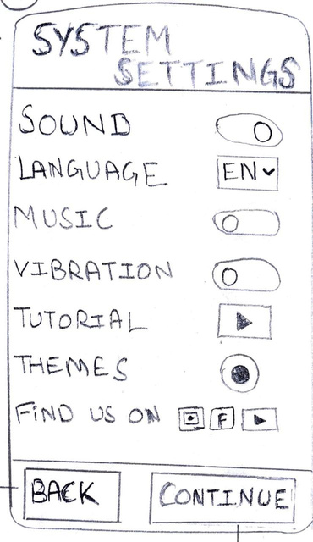
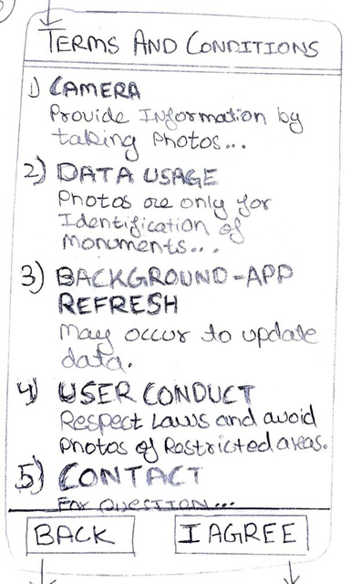
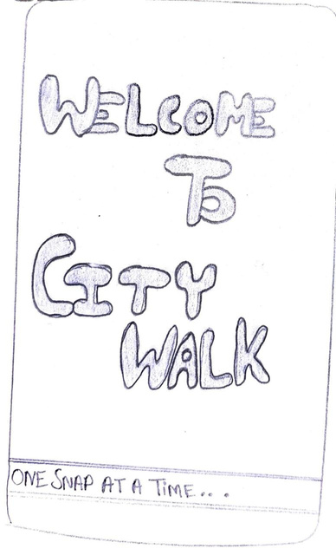
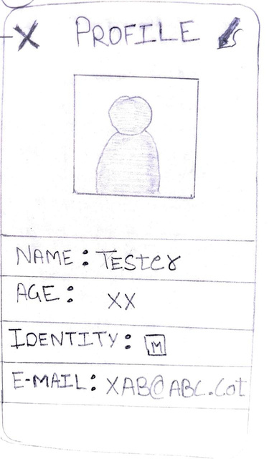
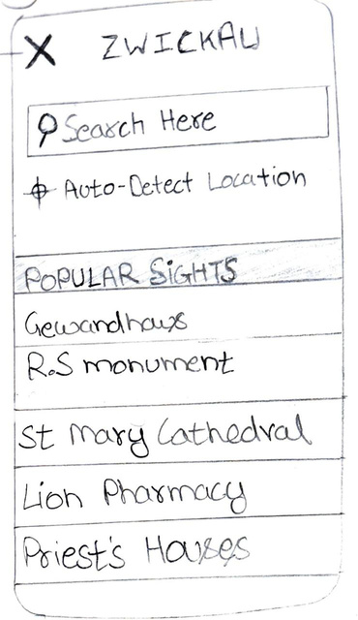
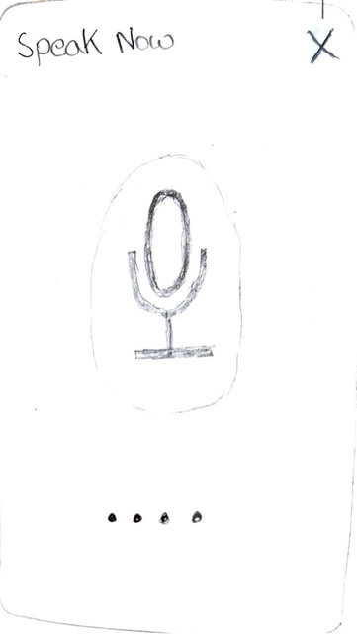
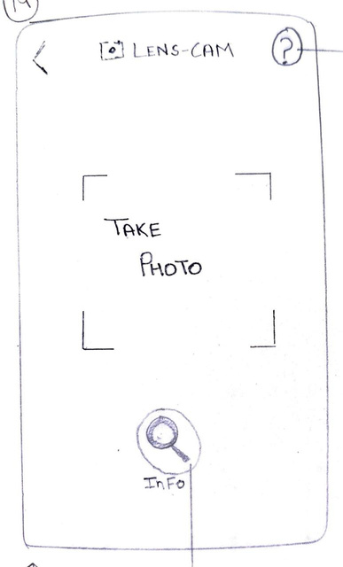
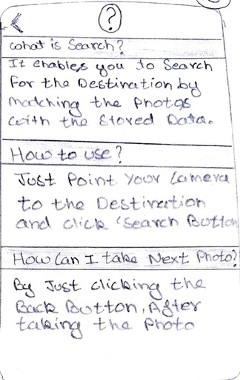
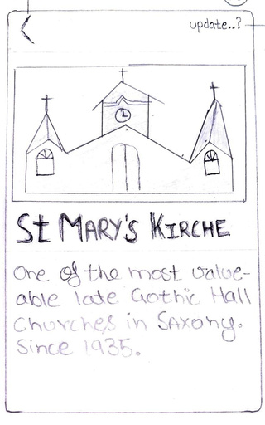
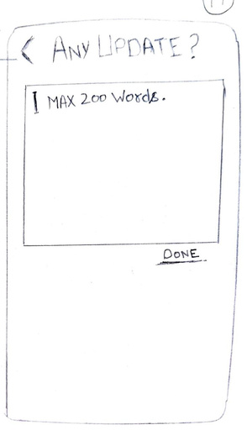
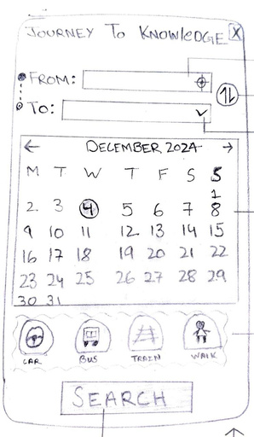
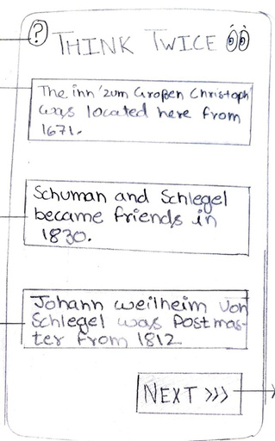
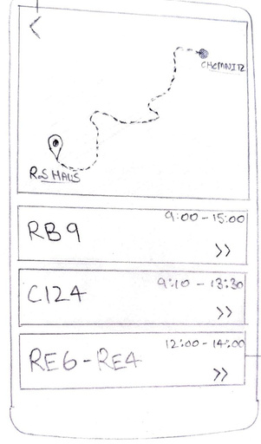
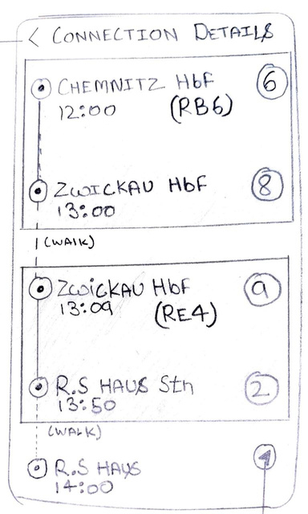
PAPER PROTOTYPES
Ravi Verma

Slide 9
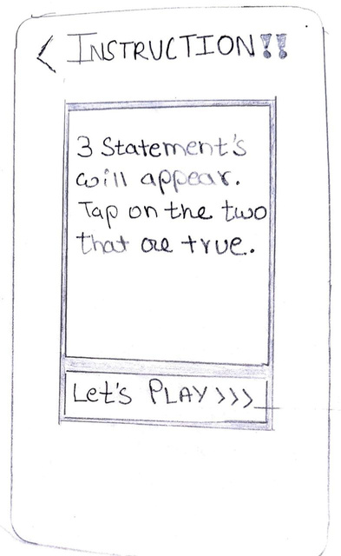
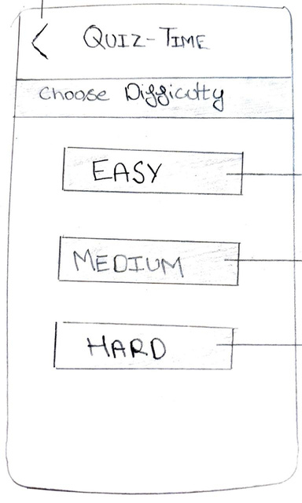
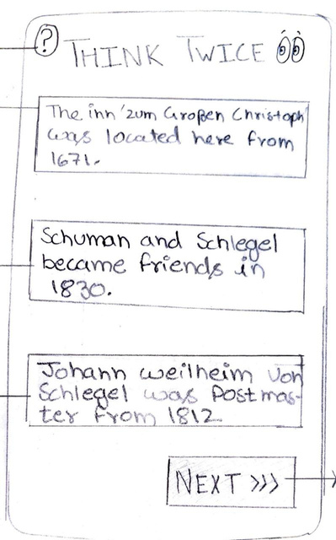
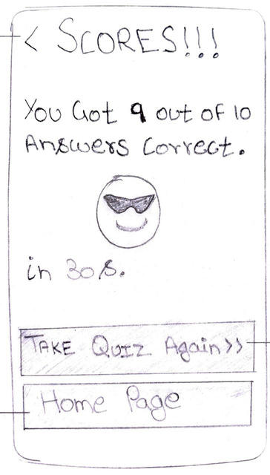
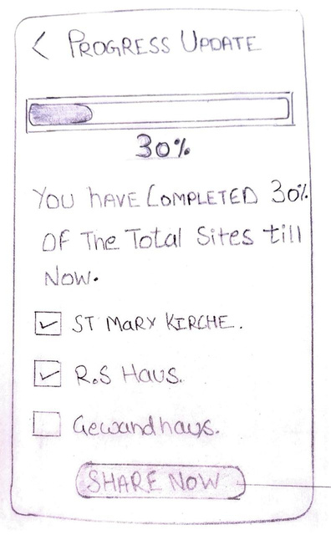

Slide 10
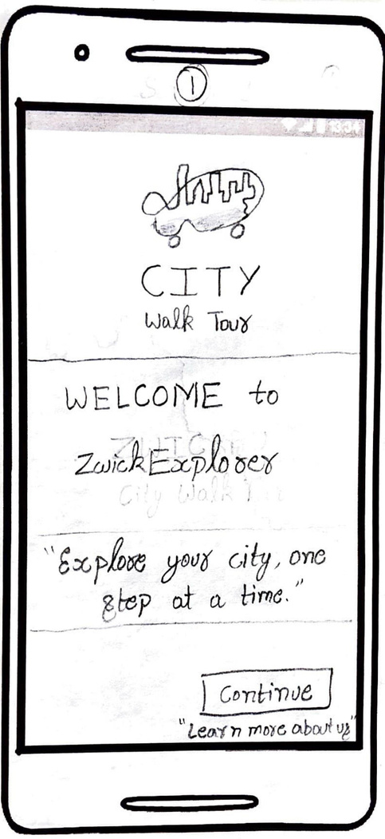
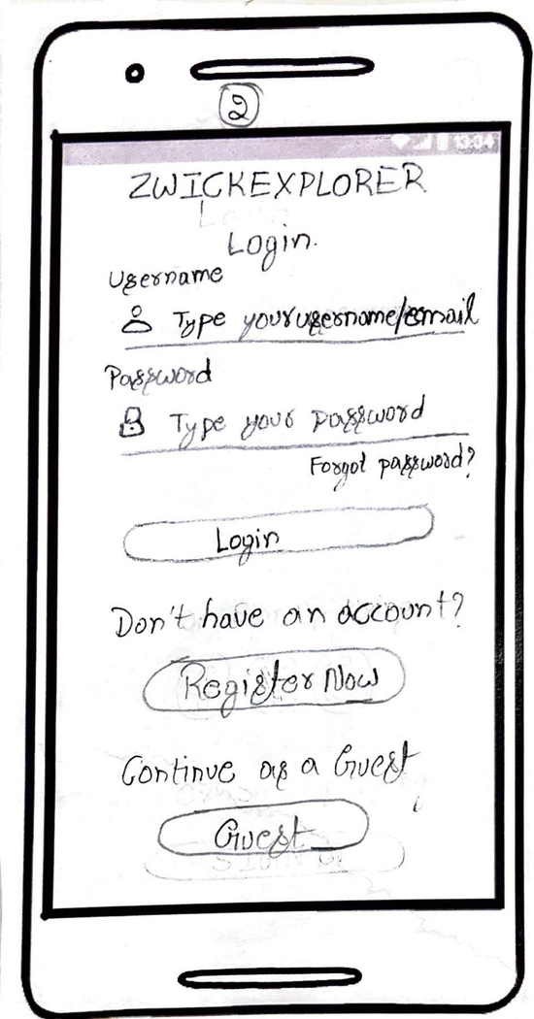
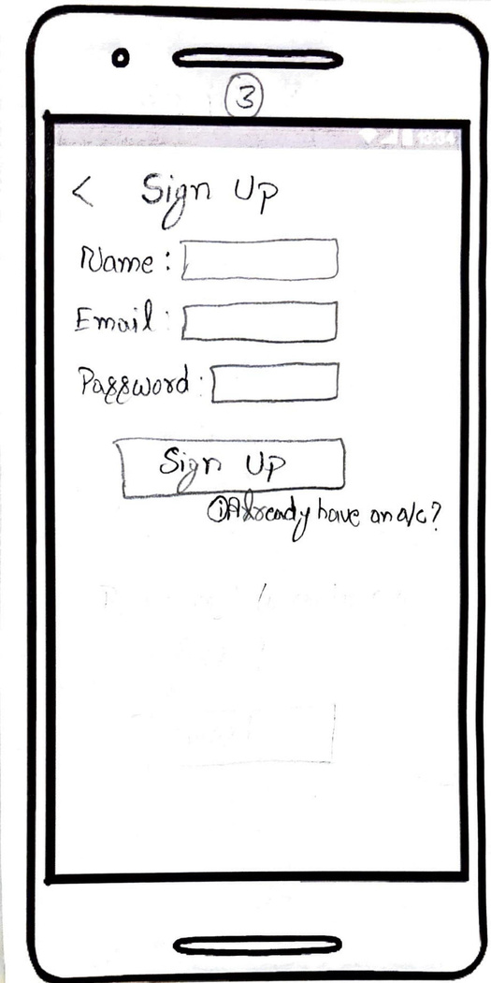
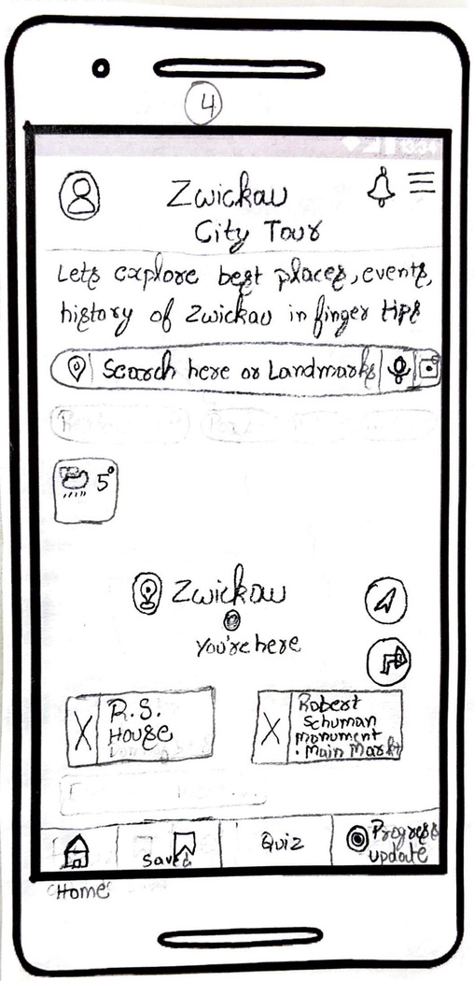
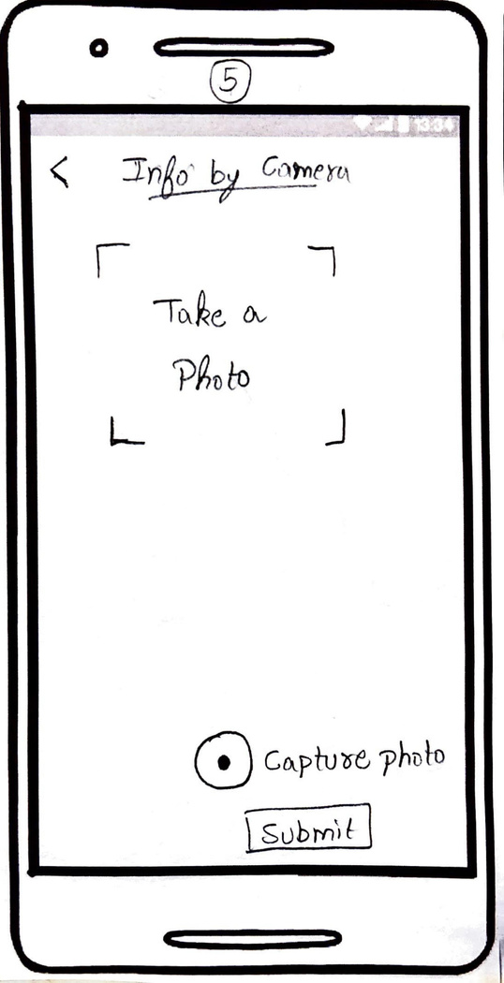
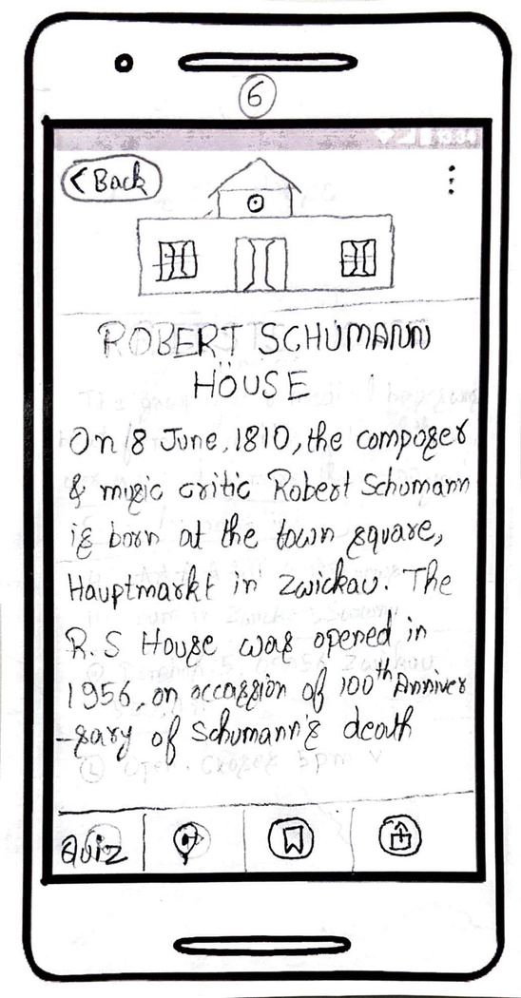
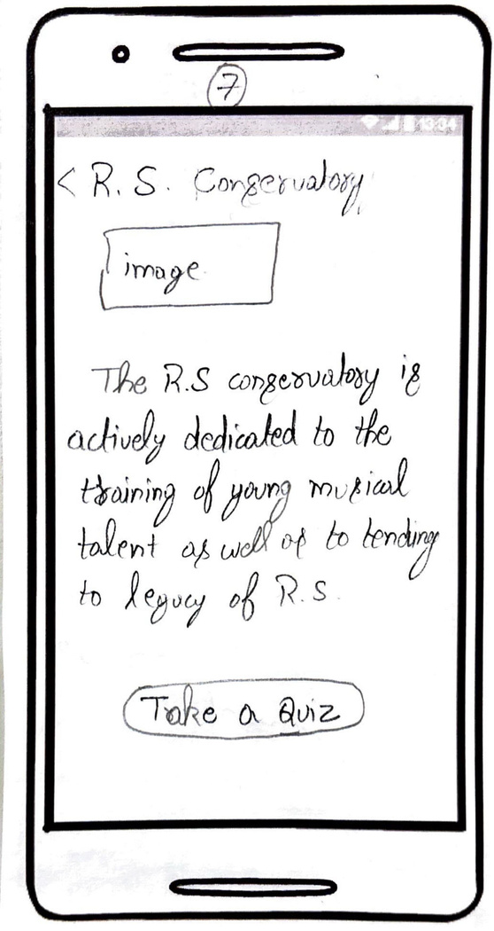
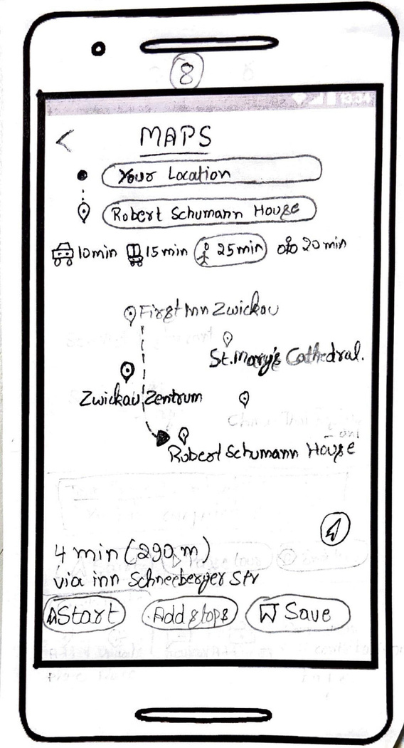
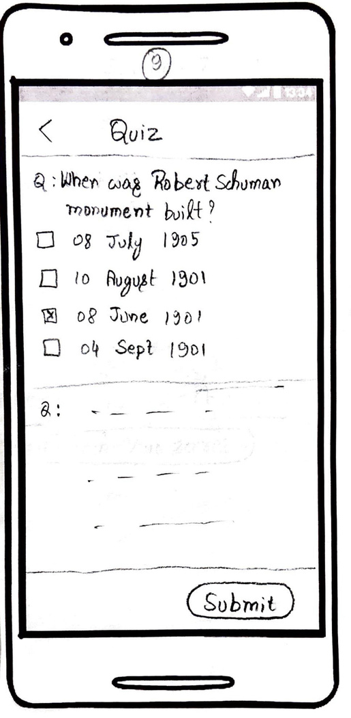
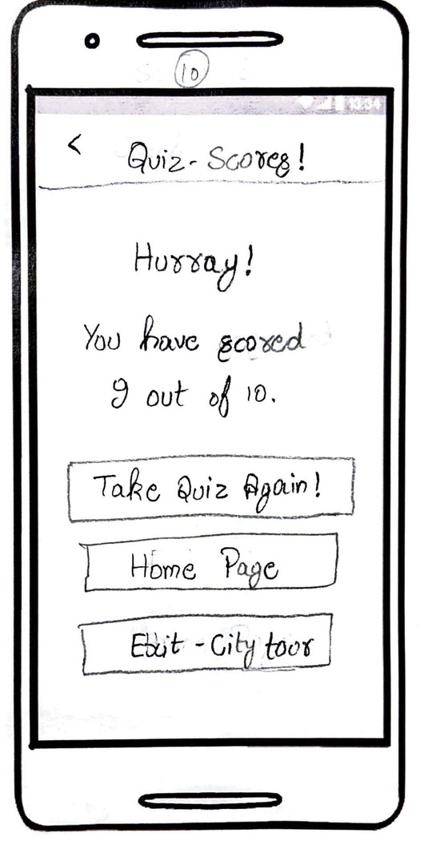
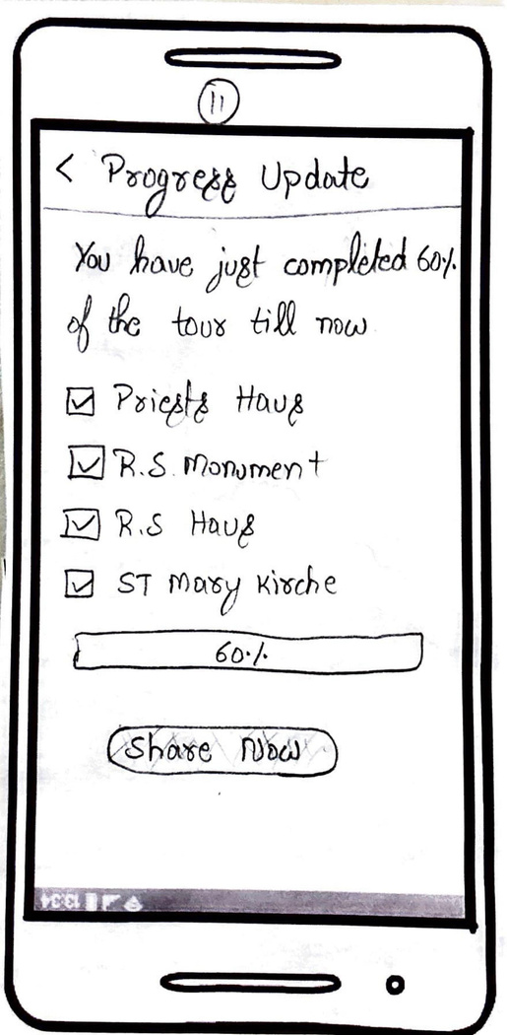
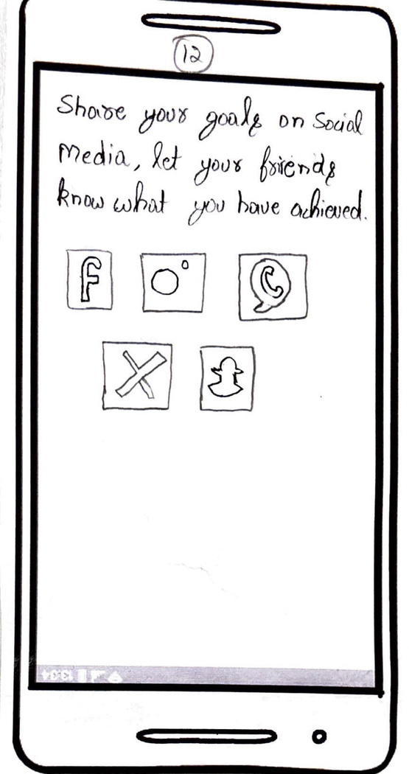
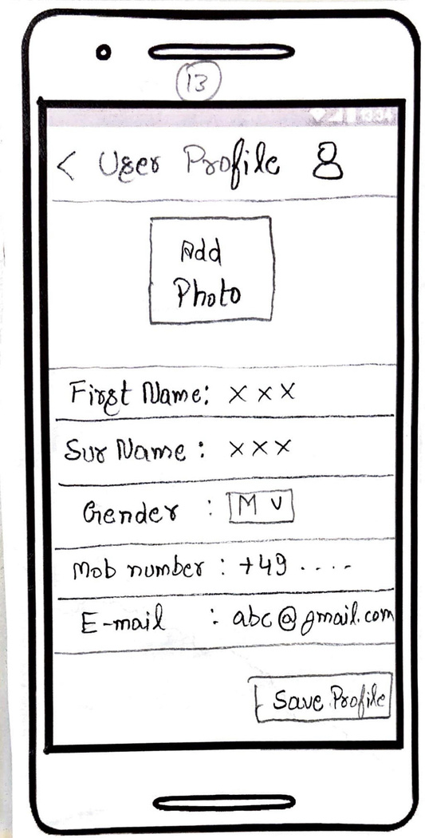
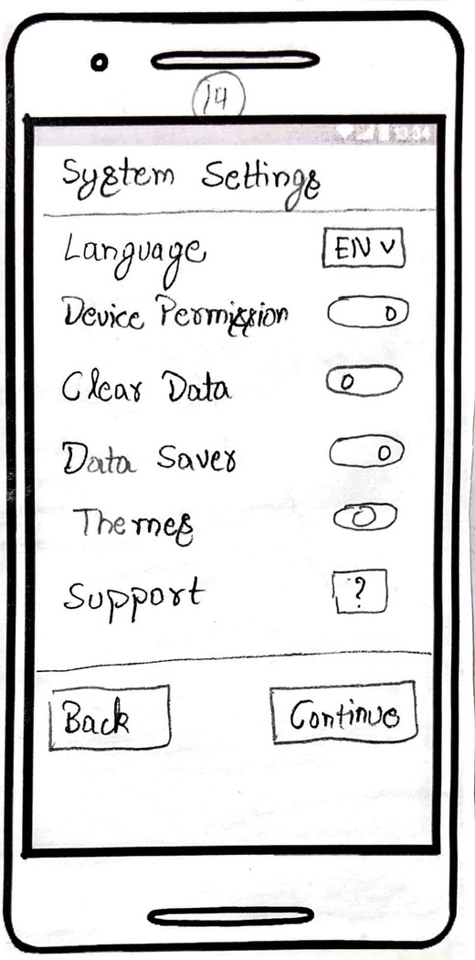
Pavan Karehalli Manjegowda

Slide 11
TEST TASKS
To evaluate only the most important and crucial features, test tasks were developed. For the matching low-fidelity paper sketches, three sets of test tasks were created. In order to determine how well the functionality can be implemented, these test tasks seek to meet a set of success conditions.
Success Requirements:
User Account Management (creating a new user Account in the application)
Informative description (capturing the image)
Language Support: Offer content in English and German
Navigation(providing navigation)
Interactive gamification(providing quizzes)
User-friendly Accessibility
Three distinct users participated in the anonymous tests. Without giving specific instructions on how to complete the activities, the test tasks were written in such a way that the user being tested was capable of understanding them. Though they are formatted differently to test various chunks of the same functions, the tasks in each of our prototypes eventually test the same scenarios.

Slide 12
Test tasks for the prototype
Please log in to the Application
Please use the application for navigation
Assume now you are Robert Schumann’s house please take a picture
Click on the image to get detailed information about the sight
Now you have arrived at Schumann’s house please take up the quizz.
ITERATIVE EVALUATION
Login Page: User 1 had trouble navigating the welcome page, so it was fixed before testing with another user. However, User 2 discovered that the Guest was deceiving them, so it was fixed before testing with User 3.
Sight Navigation: All three users experienced no problems, and they enjoyed the navigation path.
Camera: All three users had no trouble capturing images, and they also tested the search and voice-assistant features.
Sight information: User1 did not want to play the quiz and therefore required sight information directly, which was rectified by providing an option before testing with other users.
Gamification: user2 was dissatisfied with the game pattern, thus it was corrected using a new strategy .

Slide 13
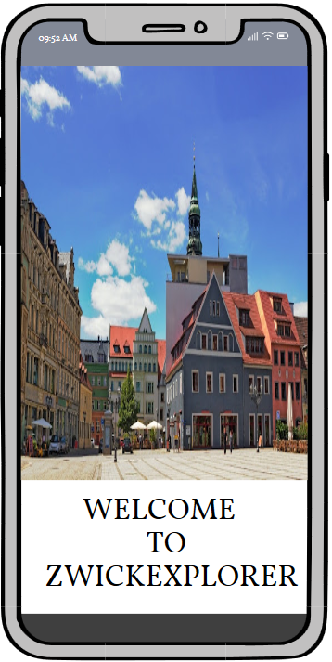
ZWICKEXPLORER
We have a visually appealing welcome page.

Slide 14
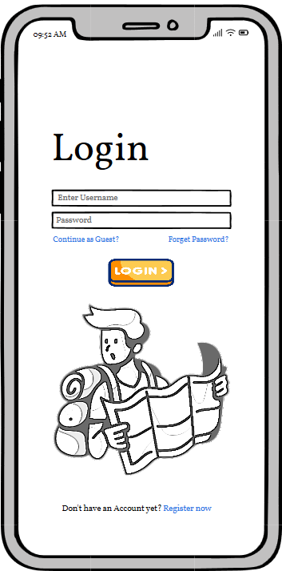
ZwickExplorer has simple yet Volatile Login/Register and Continue as Guest Function.

Slide 15
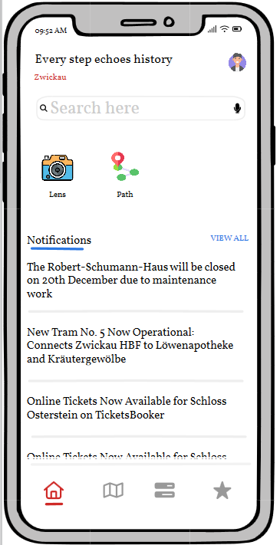
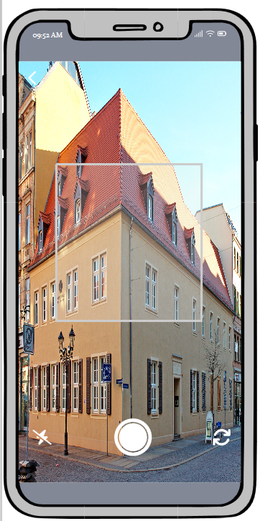
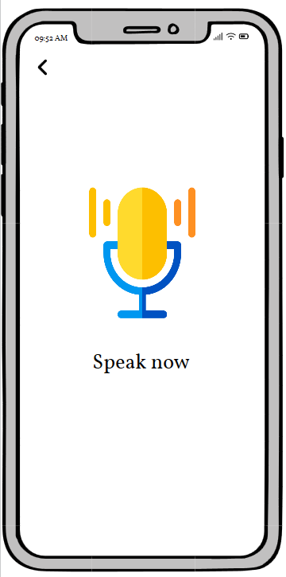
Home Screen includes the smartphone's camera, Search and voice-assisstant features which functions image recognition, voice recognition or identification to enhance the experience of exploring.

Slide 16
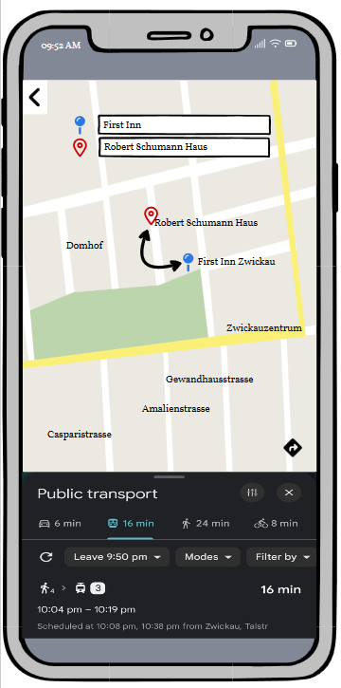
Easy Navigation: Offer a user-friendly navigation system that directs users to surrounding sights.

Slide 17
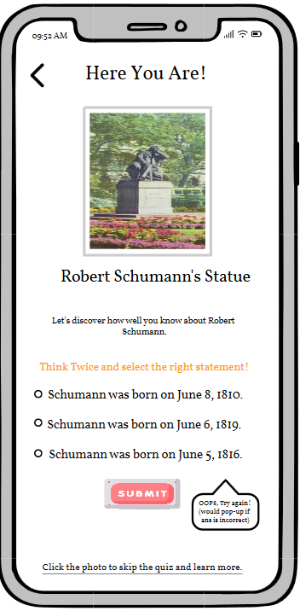
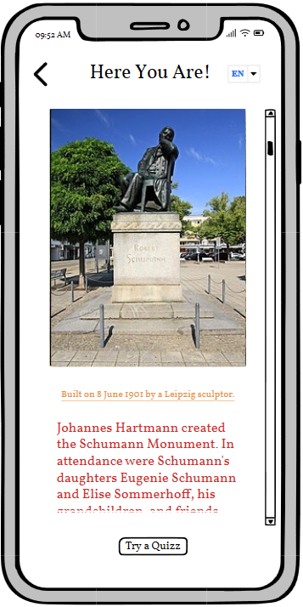
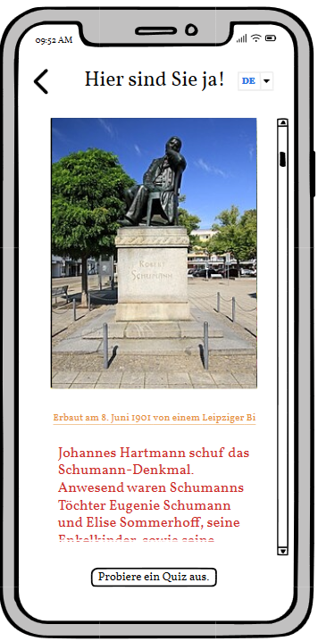
Educate users about Robert Schumann-related Zwickau attractions by providing them with interesting and interactive content with language support. Include elements that promote active participation and learning at every sight, such as mini-games or quizzes.

Slide 18
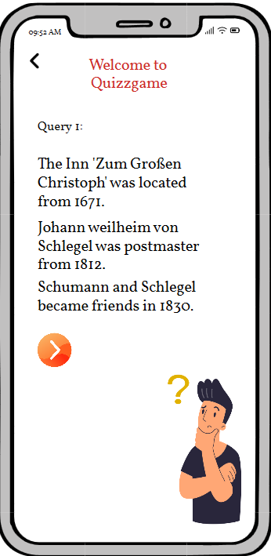



To encourage users and increase enjoyment, use game-like elements like challenges, progress monitoring, and achievements.
And then much more functionalities are present......

Slide 19







Slide 20






Slide 21
Example for using the prototype
A professional tester, academics, or a few friends may all receive an e-mail with a PDF version of the prototype. They may experiment with the various features of the prototype and contact us via support to let us know what problems they encountered.
The testing could be done over several days of use. The tester will launch the PDF prototype and attempt to configure various features in the application. Errors can be communicated to us either immediately or later via the support system. The same holds good for any favorable suggestions or feedback.

Slide 22
Conclusion
The vital errors in our design that were otherwise clear to us were found with the aid of think-aloud usability testing. Additionally, evaluating a number of users gave us the chance to further develop our ideas on the features incorporated into the low-fidelity sketches. Because the sketches were done with paper and pencil, they could be reused, allowing for small financial outlays. Understanding the successes and failures associated with the appropriate functionality was made possible by the test tasks' precise conduct.
Testing the paper prototypes led to the development of the Balsamiq prototype, which is a far improved version of the same basic design. Testing the Balsamiq in a more realistic setting in the future can help refine the prototype even more, advancing it to the development of a real application.

Slide 23

Westsächsische Hochschule Zwickau
THANK YOU
for your time and attention
Presented by Group2 (1)

